Slide 1
Artificial Intelligence: Games

Slide 2
Outline
What are games?
Optimal decisions in games
  Which strategy leads to success?
α-β pruning
Games of imperfect information
Games that include an element of chance

Slide 3
You must know …
Minimax algorithm
Alpha-beta pruning
Games of chance
in the context of two rational players

Slide 4
What are and why study games?
Games are a form of multi-agent environment
  What do other agents do and how do they affect our success?
  Cooperative vs. competitive multi-agent environments.
  Competitive multi-agent environments give rise to adversarial search a.k.a. games
Why study games?
  Fun; historically entertaining
  Interesting subject of study because they are hard
  Easy to represent and agents restricted to small number of actions

Slide 5
Relationship of Games to Search
Search – no adversary
  Solution is (heuristic) method for finding goal
  Heuristics and CSP techniques can find optimal solution
  Evaluation function: estimate of cost from start to goal through given node
  Examples: path planning, scheduling activities
Games – adversary
  Solution is strategy (strategy specifies move for every possible opponent reply).
  Time limits force an approximate solution
  Evaluation function: evaluate “goodness” of
  game position
  Examples: chess, checkers, Othello, backgammon

Slide 6
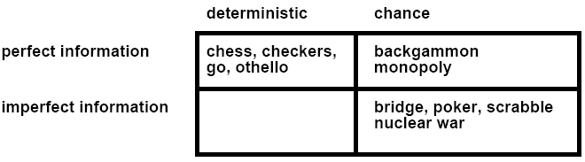
Types of Games

Slide 7
Typical Case
2-person game
Players alternate moves
Zero-sum: one player’s loss is the other’s gain
Perfect information: both players have access to complete information about the state of the game. No information is hidden from either player.
No chance (e.g., using dice) involved
Examples: Tic-Tac-Toe, Checkers, Chess, Go, Nim, Othello
Not: Bridge, Solitaire, Backgammon, ...

Slide 8
Game setup
Two players: MAX and MIN
MAX moves first and they take turns until the game is over. Winner gets award, loser gets penalty.
Games as search:
  Initial state: e.g. board configuration of chess
  Successor function: list of (move,state) pairs specifying legal moves.
  Terminal test: Is the game finished?
  Utility function: Gives numerical value of terminal states. E.g. win (+1), lose (-1) and draw (0) in tic-tac-toe
MAX uses search tree to determine next move.

Slide 9
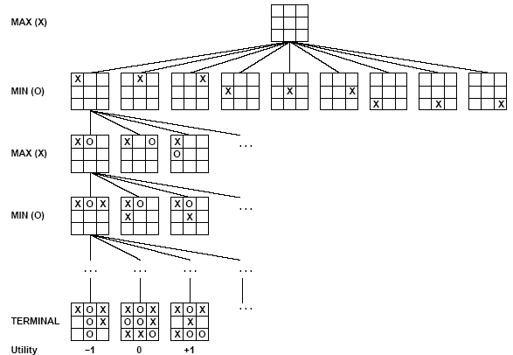
Partial Game Tree for Tic-Tac-Toe

Slide 10
Optimal strategies
Find the contingent strategy for MAX assuming an infallible MIN opponent.
Assumption: Both players play optimally !!
Given a game tree, the optimal strategy can be determined by using the minimax value of each node:
MINIMAX-VALUE(n) =
UTILITY(n) If n is a terminal
max_{s ∈ successors(n)} MINIMAX-VALUE(s) If n is a max node
min_{s ∈ successors(n)} MINIMAX-VALUE(s) If n is a min node

Slide 11
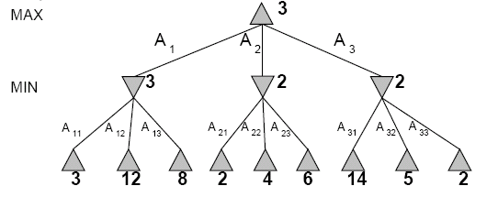
Two-Ply Game Tree

Slide 12
Two-Ply Game Tree

Slide 13
Two-Ply Game Tree

Slide 14
Two-Ply Game Tree
The minimax decision
Minimax maximizes the worst-case outcome for max.

Slide 15
What if MIN does not play optimally?
Definition of optimal play for MAX assumes MIN plays optimally: maximizes worst-case outcome for MAX.
But if MIN does not play optimally, MAX will do even better. [proven.]

Slide 16
Minimax Algorithm
function MINIMAX-DECISION(state) returns an action
inputs: state, current state in game
v←MAX-VALUE(state)
return the action in SUCCESSORS(state) with value v
function MAX-VALUE(state) returns a utility value
if TERMINAL-TEST(state) then return UTILITY(state)
v ← - ∞
for a,s in SUCCESSORS(state) do
v ← MAX(v,MIN-VALUE(s))
return v
function MIN-VALUE(state) returns a utility value
if TERMINAL-TEST(state) then return UTILITY(state)
v ← ∞
for a,s in SUCCESSORS(state) do
v ← MIN(v,MAX-VALUE(s))
return v

Slide 17
Properties of Minimax
Criterion | Minimax
Time | O(b^{m})
Space | O(bm)
☹
☺

Slide 18
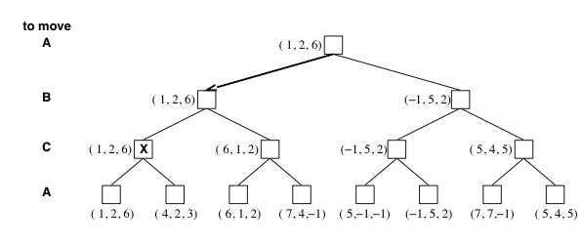
Multiplayer games
Games allow more than two players
Single minimax values become vectors

Slide 19
Problem of minimax search
Number of games states is exponential to the number of moves.
  Solution: Do not examine every node
  ==> Alpha-beta pruning
    Remove branches that do not influence final decision
Revisit example …

Slide 20
Alpha and Beta
We can use two values Alpha and Beta to prune the search tree
Alpha is the value of the highest choice we have found so far at any choice point along the path for player MAX
Beta is lowest value along path for player Min.

Slide 21
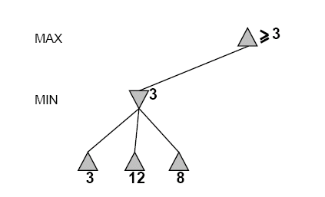
Alpha-Beta Example
Do DF-search until first leaf
Range of possible values
[-∞,+∞]
[-∞, +∞]

Slide 22
Alpha-Beta Example (continued)
[-∞,+∞]
[-∞,3]

Slide 23
Alpha-Beta Example (continued)
[-∞,+∞]
[-∞,3]

Slide 24
Alpha-Beta Example (continued)
[3,+∞]
[3,3]

Slide 25
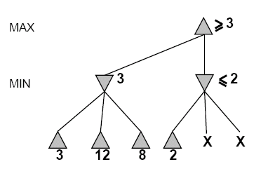
Alpha-Beta Example (continued)
[3,+∞]
This node is worse
for MAX
[3,3]
[-∞,2]

Slide 26
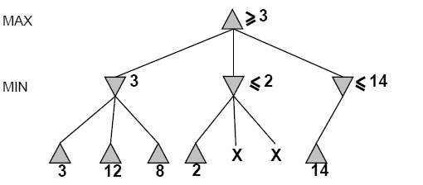
Alpha-Beta Example (continued)
[3,14]
,
[3,3]
[-∞,2]
[-∞,14]

Slide 27
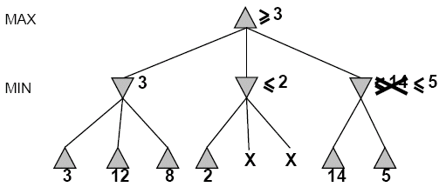

Alpha-Beta Example (continued)
[3,5]
,
[3,3]
[−∞,2]
[-∞,5]

Slide 28
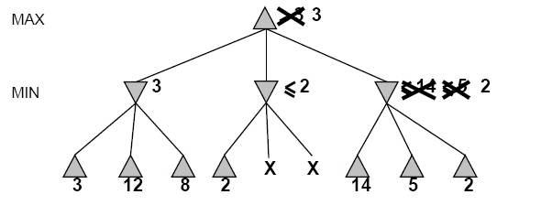
Alpha-Beta Example (continued)
[3,3]
[3,3]
[−∞,2]
[2,2]

Slide 29
Alpha-Beta Example (continued)
[3,3]
[3,3]
[-∞,2]
[2,2]

Slide 30
Alpha-Beta Pruning
Beta cutoff: Given a MAX node n, cut off the search below n (i.e., don’t generate or examine any more of n’s children) if alpha(n) ≥ beta(i) for some MIN node ancestor i of n.
Alpha cutoff: stop searching below MIN node n if beta(n) ≤ alpha(i) for some MAX node ancestor i of n.
α
β
β
α

Slide 31
Alpha-Beta Algorithm
function ALPHA-BETA-SEARCH(state) returns an action
inputs: state, current state in game
v←MAX-VALUE(state, - ∞ , +∞)
return the action in SUCCESSORS(state) with value v
function MAX-VALUE(state,α , β) returns a utility value
if TERMINAL-TEST(state) then return UTILITY(state)
v ← - ∞
for a,s in SUCCESSORS(state) do
v ← MAX(v,MIN-VALUE(s, α , β))
if v ≥ β then return v
α ← MAX(α ,v)
return v

Slide 32
Alpha-Beta Algorithm
function MIN-VALUE(state, α , β) returns a utility value
if TERMINAL-TEST(state) then return UTILITY(state)
v ← + ∞
for a,s in SUCCESSORS(state) do
v ← MIN(v,MAX-VALUE(s, α , β))
if v ≤ α then return v
β ← MIN(β ,v)
return v

Slide 33
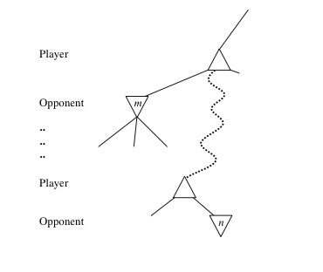
General alpha-beta pruning
Consider a node n somewhere in the tree
If player has a better choice at
  Parent node of n
  Or any choice point further up
n will never be reached in actual play.
Hence when enough is known about n, it can be pruned.

Slide 34
Final Comments about Alpha-Beta Pruning
Pruning does not affect final results
Entire subtrees can be pruned.
Good move ordering improves effectiveness of pruning
With “perfect ordering,” time complexity is O(b^{m/2})
  Branching factor of sqrt(b) !!
  Alpha-beta pruning can look twice as far as minimax in the same amount of time
Repeated states are again possible.
  Store them in memory = transposition table

Slide 35
Games of imperfect information
Minimax and alpha-beta pruning require too many leaf-node evaluations.
May be impractical within a reasonable amount of time.
SHANNON (1950):
  Cut off search earlier (replace TERMINAL-TEST by CUTOFF-TEST)
  Apply heuristic evaluation function EVAL (replacing utility function of alpha-beta)

Slide 36
Cutting off search
Change:
  if TERMINAL-TEST(state) then return UTILITY(state)
into
  if CUTOFF-TEST(state,depth) then return EVAL(state)
Introduces a fixed-depth limit depth
  Is selected so that the amount of time will not exceed what the rules of the game allow.
When cutoff occurs, the evaluation is performed.

Slide 37
Heuristic EVAL
Idea: produce an estimate of the expected utility of the game from a given position.
Performance depends on quality of EVAL.
Requirements:
  EVAL should order terminal-nodes in the same way as UTILITY.
  Computation may not take too long.
  For non-terminal states the EVAL should be strongly correlated with the actual chance of winning.
Only useful for quiescent (no wild swings in value in near future) states

Slide 38
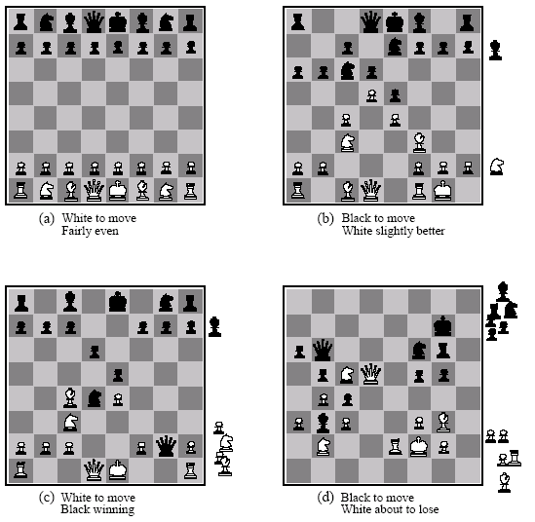
Heuristic EVAL example
Eval(s) = w₁ f₁(s) + w₂ f₂(s) + … + w_{n}f_{n}(s)

Slide 39
Heuristic EVAL example
Addition assumes
independence
Eval(s) = w₁ f₁(s) + w₂ f₂(s) + … + w_{n}f_{n}(s)

Slide 40
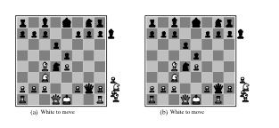
Heuristic difficulties
Heuristic counts pieces won

Slide 41
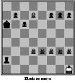
Horizon effect
Fixed depth search
thinks it can avoid
the queening move

Slide 42
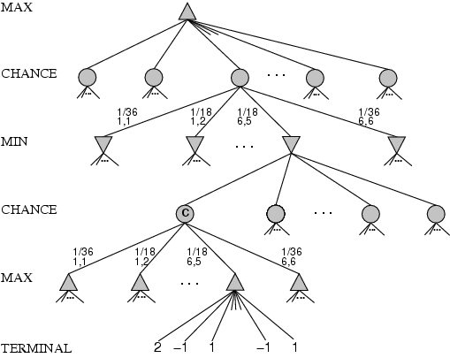
Games that include chance
Possible moves (5-10,5-11), (5-11,19-24),(5-10,10-16)
and (5-11,11-16)

Slide 43
Games that include chance
chance nodes
Possible moves (5-10,5-11), (5-11,19-24),(5-10,10-16) and (5-11,11-16)
[1,1], [6,6] chance 1/36, all other chance 1/18

Slide 44
Games that include chance
[1,1], [6,6] chance 1/36, all other chance 1/18
Can not calculate definite minimax value, only expected value

Slide 45
Expected minimax value
EXPECTED-MINIMAX-VALUE(n)=
UTILITY(n) If n is a terminal
max_{s ∈ successors(n)} MINIMAX-VALUE(s) If n is a max node
min_{s ∈ successors(n)} MINIMAX-VALUE(s) If n is a max node
∑_{s ∈ successors(n)} P(s) . EXPECTEDMINIMAX(s) If n is a chance
node
These equations can be backed-up recursively all the way to the root of the game tree.

Slide 46
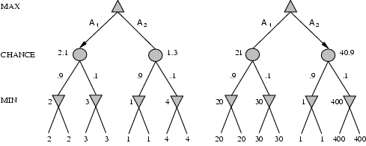
Position evaluation with chance nodes
Left, A1 wins
Right A2 wins
Outcome of evaluation function may not change when values are scaled differently.
Behavior is preserved only by a positive linear transformation of EVAL.

Slide 47
Summary
Games are fun
They illustrate several important points about AI
  Perfection is unattainable -> approximation
  Good way to focus on basic problems in search and reasoning
  Uncertainty constrains the assignment of values to states
Games are to AI what grand prix racing is to automobile design.

Slide 48
